Slide 1
Dr.K.Ramesh NIT Warangal
Linux Device Drivers
Disclaimer: Kernel Modules are dangerous and can
render a system useless by corrupting hardware as
well as software, not responsible for any damage.

Slide 2
What is Linux?
Linux is a very widely used open source operating system.
Why Linux? Why not windows or Mac Os?
What is the difference between Linux and Unix?
What Linux is good “Ubuntu”,“Fedora”,…?

Slide 3
Linux File System
Almost everything in Linux is a file, some that can be read directly with programs like vi, gedit… and others require special programs which parse the data.
Some directories
  /usr stores application programs
  /var stores logfiles, mails…
  /tmp stores temporary stuff
  /dev stores all the device drivers
  /proc stores all running process and their information
  /mnt contains all the file systems that are mounted(C drive cdrom drive…)
  /etc contains all the configuration files and so on.

Slide 4
Types of Devices
In Linux drivers written outside of the kernel are referred to as modules.
Virtual
  The individual Hardware simply does not exist. ex. Loop devices.
Physical
  They have a hardware component.
Bus-Based
  Drives don’t have direct communication with the hardware but only through a Bus-Driver.

Slide 5
Types
Character Devices
- allows serial access of data bytes
- Mice, Keyboard, Serial Port, et cetera
Block Devices
- transfers a block of bytes as a unit
- allows random access to independent, fixed sized blocks of data
- hard drive, cd-rom, et cetera
Network Devices
- dealt differently from the above two
- users can’t directly transfer data to network devices
- communicate indirectly by opening a connection to the kernel’s networking system.

Slide 6
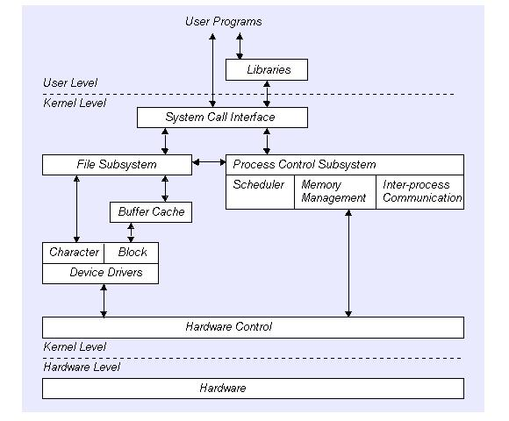
Device Driver Interface

Slide 7
Device Driver Interface

Slide 8
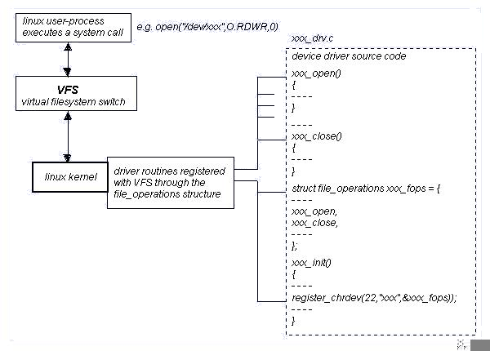
Mapping calls to dev functions

Slide 9
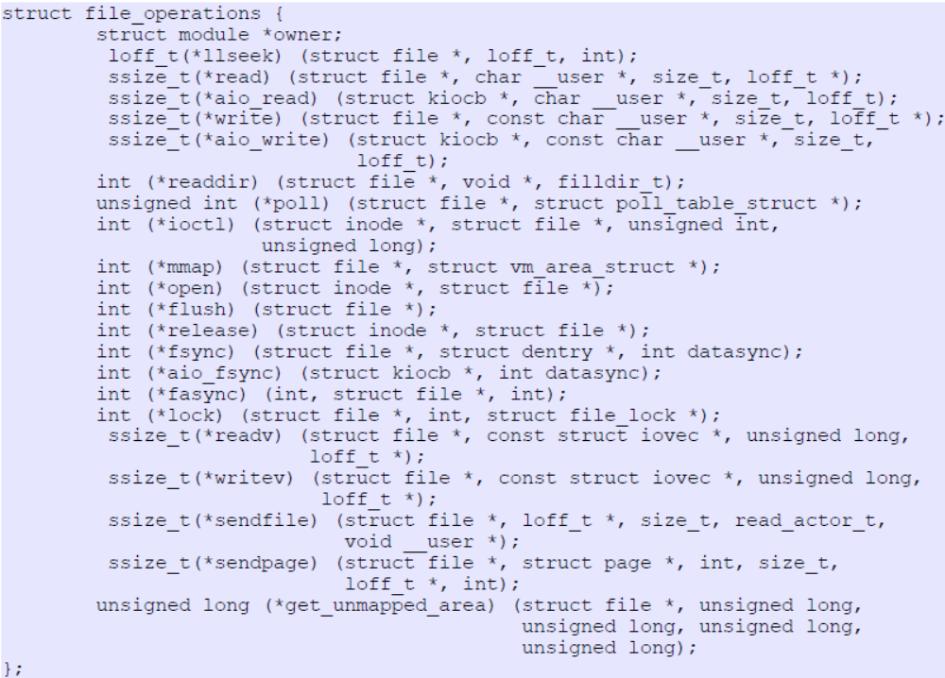
Kernel Modules as Device Drivers
int register_chrdev(unsigned int major, const char *name, struct file_operations *fops);
The definition of the file_operations structure looks like this

Slide 10
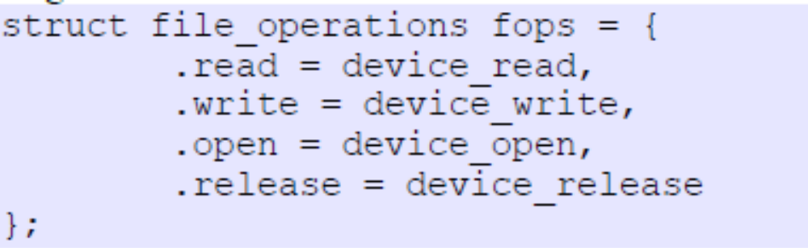
As already mentioned not all the fields of this structure need to be initialized, only those corresponding to operations supported by the device driver.
An initialization of this structure might look like this:

Slide 11
Our First Device Driver
Lets go against convention and skip the “Hello World” device driver and get down to the real deal.
Our first device will be a device which will display and set the clock.
A little background on clocks.
There is a hardware clock and a software clock
Software clock does not work when the computer is off.
But when the computer starts the hardware clock is used to set the software clock.
Once the computer starts the software clock is dominant and sets the hardware clock every 11 minutes or so. Why 11? Someones luck number

Slide 12
Project Goals
Outline of what we have to do:
Name our device, lets name it TickTock
Read the software time
Write the software time
That's all!!

Slide 13
The Code (Header)
#include <linux/module.h>
#include <linux/string.h>
#include <linux/kernel.h>
#include <linux/time.h>
#include <linux/fs.h>
#include <asm/uaccess.h>
static int Tick_init(void);
static void Tock_exit(void);
static int opendev(struct inode *, struct file *);
static int closedev(struct inode *, struct file *);
static ssize_t readme(struct file *, char *, size_t, loff_t *);
static ssize_t writeme(struct file *, const char *, size_t, loff_t *);
static int Major;
#define SUCCESS 0
#define DEVICE_NAME "TickTock"
static struct file_operations fops = {
.read = readme,
.write = writeme,
.open = opendev,
.release = closedev
};

Slide 14
Init
static int Tick_init(void){
Major = register_chrdev(0, DEVICE_NAME, &fops);
if(Major>0){
printk("TickTock is Ready For Requests!: %d\n",Major);
return 0;
}else{
printk("Something Bad happened : %d",Major);
}
}
module_init(Tick_init);

Slide 15
Deinit
static void Tock_exit(void)
{
unregister_chrdev(Major, DEVICE_NAME);
printk("Goodbye Crewl World!\n");
}
module_exit(Tock_exit);

Slide 16
License?
MODULE_LICENSE("GPL");

Slide 17
Open and Close
static int opendev(struct inode * a, struct file * b){
printk("Someone opened me!\n");
//nothing to do!!!
return SUCCESS;
}
static int closedev(struct inode * a, struct file * b){
//nothing to do!!
printk("Someone Closed me!\n");
return SUCCESS;
}

Slide 18
Random Utility Functions
int pow(int a, int b);
static int itoa(int val,char** ca);
int atoi(char * buff);

Slide 19
Read
static ssize_t readme(struct file *filp,char *buffer,size_t length,loff_t *offset) {
int len;
struct timeval time;
do_gettimeofday(&time);
char *b;
b=kmalloc(sizeof(char)*40,GFP_KERNEL);
len=itoa(time.tv_sec,&b);
copy_to_user(buffer,b,len);
printk("Return val:%s\n",b);
return length;
}

Slide 20
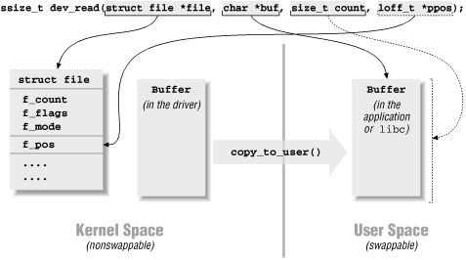
Read() and write()

Slide 21
Write
static ssize_t writeme(struct file *filp,const char *buff,size_t len, loff_t *off)
{
int i=atoi(buff);
struct timespec ab;
ab.tv_sec=i;
ab.tv_nsec=0;
do_settimeofday(&ab);
return len;
}

Slide 22
Finished?
And the coding is complete!
There is really no logic involved, just coding.
So whats next?

Slide 23
The MakeFile
obj-m := ticktock.o
KDIR := /lib/modules/$(shell uname -r)/build
PWD := $(shell pwd)
default:
$(MAKE) -C $(KDIR) M=$(PWD) modules

Slide 24
How many more Steps?!?!
In shell type: make
It will generate a bunch of files
The one that interests us is the file ending in *.ko
Go into super user su
Insmod ./TickTock.ko
Dmesg | tail
Mknod /dev/TickTock c Major 0

Slide 25
Done!!
That's all its finished!
Just open the /dev/TickTock as a normal file with read /write / or both
Read will give a string representing the number of seconds since a certain day usually Jan 1, 1970 0:00
Write will accept a string of a number representing the number of seconds since a certain day usually Jan 1, 1970 0:00 and set the clock accordingly
Now block device drivers are the same as character drivers with a few changes that allows them to transfer blocks of data instead of character by character

Slide 26
#include<linux/module.h>
#include<linux/kernel.h>
#include<linux/version.h>
#include<linux/string.h>
#include<linux/uaccess.h>
#include<linux/time.h>
#include<linux/fs.h>
#include<linux/slab.h>
static ssize_t readtime(struct file *,char *,size_t ,loff_t *);
static ssize_t writetime(struct file *,const char *,size_t ,loff_t *);
static int open_dev(struct inode *,struct file *);
static int closedev(struct inode *,struct file *);
int major;
void reverse(char str[], int length)
{
int start = 0;
int end = length -1;
while (start < end)
{
swap(*(str+start), *(str+end));
start++;
end--;
}
}
char *b;
int atoi(const char * str)
{
int res = 0,i=0; // Initialize result
// Iterate through all characters of input string and
// update result
for (i = 0; str[i] != '\0'; ++i)
res = res*10 + str[i] - '0';
// return result.
return res;
}
static struct file_operations fops={
.open=open_dev,
.release=closedev,
.read=readtime,
.write=writetime,
};
static ssize_t readtime(struct file *filep,char *buff,size_t len,loff_t *f_ops)
{
char *b=kmalloc(40*sizeof(char),GFP_KERNEL);
struct timeval t1;
do_gettimeofday(&t1);
sprintf(b,"%ld",t1.tv_sec);
copy_to_user(buff,b,strlen(b));
printk("Reading\n");
return len;
}
ssize_t writetime(struct file *filp,const char *buff,size_t len, loff_t *off)
{
char *b=kmalloc(30*sizeof(char),GFP_KERNEL);
copy_from_user(b,buff,len);
long int i=atoi(b);
struct timespec ab;
ab.tv_sec=i;
ab.tv_nsec=0;
// printk("%s",buff);
do_settimeofday(&ab);
return len;
}
static int open_dev(struct inode *a,struct file *filep)
{
printk("Ticktock device has been opened..\n");
return 0;
}
static int closedev(struct inode *a,struct file *filep)
{
printk("Ticktock device closed just now..\n");
return 0;
}
static int __init tick_tock_start(void)
{
if((major=(register_chrdev(0,"mydev1",&fops)))<0)
{
goto fail;
}
printk("Ticktock device has been loaded...%d\n",major);
return 0;
fail:
return -1;
}
static void __exit tick_tock_end(void)
{
unregister_chrdev(major,"mydev1");
printk("Ticktock device unloaded just now..\n");
}
module_init(tick_tock_start);
module_exit(tick_tock_end);
MODULE_LICENSE("GPL");
MODULE_AUTHOR("3BTCSENITW");
MODULE_DESCRIPTION("TICK TOCK TIME");

Slide 27
// Required header files
#include<stdio.h>
#include<stdlib.h>
#include<errno.h>
#include<fcntl.h>
#include<string.h>
#include<unistd.h>
#define BUFFER_LENGTH 256 ///< The buffer length (crude but fine)
static char receive[BUFFER_LENGTH]; ///< The receive buffer from the LKM
int main()
{
int fd=open("/dev/mydev1",O_RDWR); // opens the device driver which has been loaded
printf("%d\n",fd);
char buf[100];
int c=read(fd,buf,sizeof(100)); // reads the time of the system through device driver
printf("%d out read %s\n",c,buf); // prints the system time in seconds(nu)
memset(buf,0,256);
scanf("%s",buf); // takes input from user to which current time has to be set
c=write(fd,buf,strlen(buf)); // writes the time this changes the system time
printf("%d out write \n",c); // prints size of char buffer
close(fd);
return 0;
}

